Slide 1
Communication in Node.js
View Mastering Node.js course details at www.edureka.co/mastering-node-js

Slide 2





What will you learn today?
Introduction of Node.js
Use Cases of Node.js
Network Communication in Node.js
Two Way Communication in Node.js

Slide 3
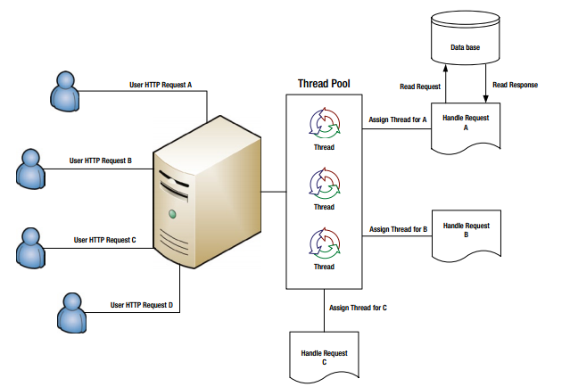
Traditional Multithreaded Model

Slide 4
Problem with Multithreaded Model
Thread 1
Thread 2
Thread 3
wants to update
wants to update
Shared Resource
wants to update
In a multi-threaded HTTP server, for each and every request that the server receives, it creates a separate thread which handles that request
If a request acquires a lock in the shared resource and it is ‘exclusive’, it will affect result of other requests

Slide 5
Single Threading
On the other hand, framework like Node.js is event driven, handling all requests asynchronously from single thread
Almost no function in Node directly performs I/O, so the process never blocks
One Thread at a Time
Event Queue
Thread Pool
file system
Event
Loop
network
process
other

Slide 6
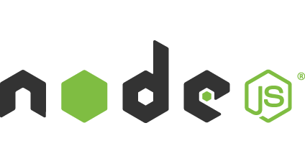
What is Node.js ?
Node.js is a server-side runtime environment for networking applications. It is single threaded.
Node.js applications are written in JavaScript, and its open source based on Google’s V8 JavaScript Engine
It is cross platform and can run within the Node.js runtime on OS X, Microsoft Windows, Linux, FreeBSD, NonStop and IBM

Slide 7
Node.js Detailed Architecture
Event Queue
Request 1
Request 2
Request n
Request 1
Pick up requests from queue
Client 1
Response 1
Event Loop Single Threaded
Request 1
Client 2
Request 2
No
Non-Blocking IO
Response 2
Request 1
Request 2
Blocking IO Request ?
No
Send Responses
Request 2
Non-Blocking IO
Request n
Client n
Non Blocking I/O Tasks Processed here
Response n

Slide 8
Node.js Detailed Architecture
Event Queue
Node.js Platform internal Thread Pool
Request 1
Request 2
Request n
T-1
T-2
T-m
Request 1
Pick up requests from queue
Client 1
Pick up one Thread from pool
Response 1
Event Loop Single Threaded
Request 1
Request 2
No
Database
Client 2
Non-Blocking IO
Response 2
Request 1
Request n
Request 2
Blocking IO Request ?
No
Blocking IO
Send Responses
Non-Blocking IO
Filesystem
Request 2
Request n
Request n
handle by
Client n
Non Blocking I/O Tasks Processed here
Yes
Response n
Thread T-1
Send Response to Request n

Slide 9

Use-Cases of Node.js (Contd.)
Previously LinkedIn Mobile was powered by Ruby on Rails
It was a synchronous app in which clients used to make several calls for a single page, consequently the system was bursting because of the load

Slide 10
Use-Cases of Node.js (Contd.)
Previously LinkedIn Mobile was powered by Ruby on Rails
It was a synchronous app in which clients used to make several calls for a single page, consequently the system was bursting because of the load
Advantage of using Node.js
The LinkedIN moved to Node.js which enabled them to move to a model where the client makes a single request for a page
It led to reduction in the number of machines used to host their services greater than 10:1

Slide 11


Use-Cases of Node.js (Contd.)
Ebay was making real time applications with huge number of eBay-specific services
As eBay was having java infrastructure, it consumed many more resources than expected, raising questions about scalability for production

Slide 12
Use-Cases of Node.js (Contd.)
Ebay was making real time applications with huge number of eBay-specific services
As eBay was having java infrastructure, it consumed many more resources than expected, raising questions about scalability for production
Node.js solved this issue as it is scalable because its single threaded so less overheads and that is why it utilizes the resources in the right manner, so no extra consumption of resources
Advantage of using Node.js

Slide 13
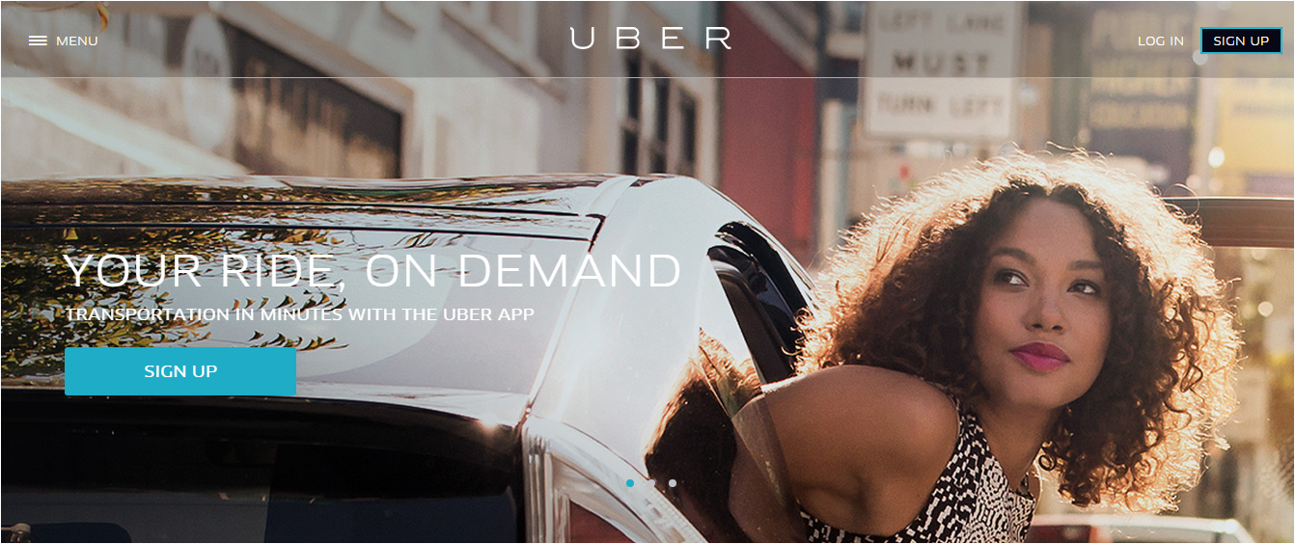
Uber’s Story
Uber is a transportation company which allows users to get a taxi, private car or rideshare from their smartphones
Uber uses NodeJS to implement their cab dispatch operation

Slide 14
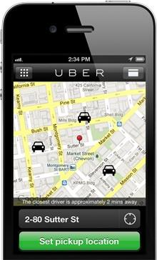
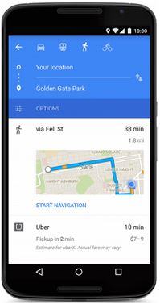
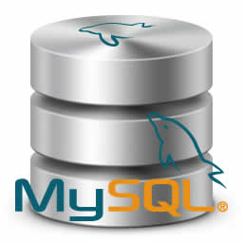
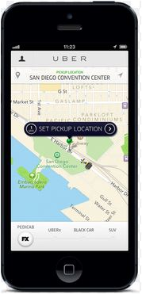
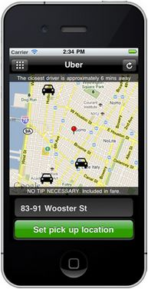
Uber - Old Architecture
PHP
PHP
PHP
PHP

Slide 15
Uber - Multiple Dispatch Problem
Since PHP is a multithreaded language , each user’s request is handled in a separate thread
Once one car is dispatched for a user, in between the same car get dispatched to another user
Reason was car dispatch operation was executed from multiple threads

Slide 16
Uber - New Architecture
Real-time Logic
Dispatch State (MongoDB)
NodeJS
Android
Dispatch(NodeJS)
iPhone
Python
Persistent Store (MySQL)
Business Logic

Slide 17
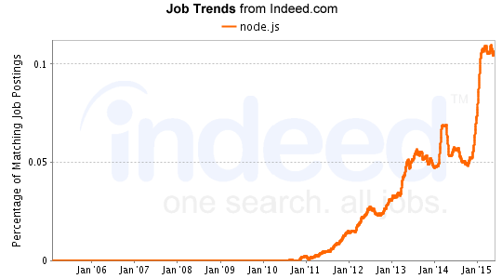
Job Trends
From the graph below : The number of jobs are skyrocketing.

Slide 18
Let us see how communication works in Node.js

Slide 19
Network Communication - TCP
For Network communication on Node.js, we use the “net” module
net.createServer([options][,callback]) :
If allowHalfOpen is true then when the other side initiates Connection Termination the server WILL NOT send the FIN packet
//options object
{
allowHalfOpen : false , pauseOnConnect : false
}
//values : true or false, default : false

Slide 20
Network Communication - TCP
//Creating a TCP Server
var net = require(‘net’);
var server = net.createServer(function(socket)
{
socket.end(‘Hello World’); //Socket is a Duplex stream
});
server.listen(3000,function()
{
console.log(“Server is listening on Port 3000”);
});

Slide 21
Network Communication - TCP
//A TCP client
var net = require(‘net’);
var socket = net.createConnection({port: 3000,host: ‘192.168.0.1’);
socket.on(‘connect’,function()
{
console.log(‘connected to the server’);
})
socket.end(‘Hello Server’);
//we can now create a command line TCP chat server and client by using the //process.stdin (Readable Stream) and process.stdout(Writable)

Slide 22
Demo

Slide 23
Two Way Communication : Socket.io
Socket.io is a fast, real-time engine.
Transmitting messages and Receiving message between client and server is simple: Events.
On server/client when sending a message use socket.emit(‘eventname’,data). “eventname” can be any string
And data can be any data: even Binary data!
On server/client when you want to listen to events-messages use socket.on(‘eventname’,callbackFunction).
Where the callbackFunction is a function that accepts a Data argument : Data sent by the other party.

Slide 24
Two Way Communication : Socket.io
A simple example:
//Server-side
var app = require('express')(); var server = require('http').Server(app); var io = require('socket.io')(server); server.listen(80); app.get('/', function (req, res) { res.sendfile(__dirname + '/index.html'); }); io.on('connection', function (socket) { socket.emit('news', { hello: 'world' }); socket.on('my other event', function (data) { console.log(data); }); });
//client-side
<script src="/socket.io/socket.io.js"></script> <script> var socket = io.connect('http://localhost'); socket.on('news', function (data) { console.log(data); socket.emit('my other event', { my: 'data' }); }); </script>

Slide 25
Two Way Communication : Socket.io
Besides ‘connect’, ‘message’ and ‘disconnect’ you can use any custom event names
You could also have a separation of concerns by namespacing. Namespacing also means, that the same websocket connection is used but is multiplexed
var io = require('socket.io').listen(80); var chat = io .of('/chat') .on('connection', function (socket) { socket.emit('a message', { that: 'only' , '/chat': 'will get' }); }); var news = io .of('/news') .on('connection', function (socket) { socket.emit('item', { news: 'item' }); });
<script> var chat = io.connect('http://localhost/chat') , news = io.connect('http://localhost/news'); chat.on('connect', function () { chat.emit('hi!'); }); news.on('news', function () { news.emit('woot'); }); </script>

Slide 26
Demo

Slide 27

Certifications
Get certified in Mastering Node.js by Edureka
Go to www.edureka.co/mastering-node-js
Edureka's Mastering Node.js course:
You will learn how to develop fast real-time network applications using Node.js, ExpressJS and MongoDB, deal with templating engines like Jade/Hogan/Handlebars and understand testing using Mocha/Jasmine
It will train you to build networking and web based applications that are far more superior and efficient than applications build in other languages.
Get to work on a To-Do List App Project towards the end of the course, which gives you complete insights on the Node.js framework.
Online Live Courses: 27 hours
Assignments: 20 hours
Project: 20 hours
Lifetime Access + 24 X 7 Support

Slide 28
Thank You
Questions/Queries/Feedback
Recording and presentation will be made available to you within 24 hours

